Slide 1
How to write a Developer CV/résumé that will get you hired
Peter Sergeant - pete@perl.careers - http://perl.careers/

Slide 2

All About Me

Slide 3
Who I am: Perl Developer
13 years commercial experience with Perl
Gave my first talk at YAPC ~ 14 years ago
15 CPAN distributions
Been a contractor, a permanent employee, and a freelancer

Slide 4
Who I am: Hiring Manager
CTO at an enterprise software company
Team of 40, most of whom were Perl developers
Spent a lot of time reading CVs, interviewing, hiring

Slide 5
Who I am: Recruiter
Run a recruitment agency called Perl Careers
Specialize in Perl developers in the UK
Please come and get a pen and a business card
They were expensive

Slide 6
Who I am: Who Cares?
The only recruiter who has been on all four sides of the table
Developer looking for work
Developer roped in to interviewing potential coworkers
Hiring manager
Recruiter
I’m going to show you how to write an awesome CV

Slide 7

The Gatekeepers

Slide 8
The Gatekeepers
Your CV has three types of people who read it
They have different requirements of it
You need to make sure it talks to all of them
They are…

Slide 9
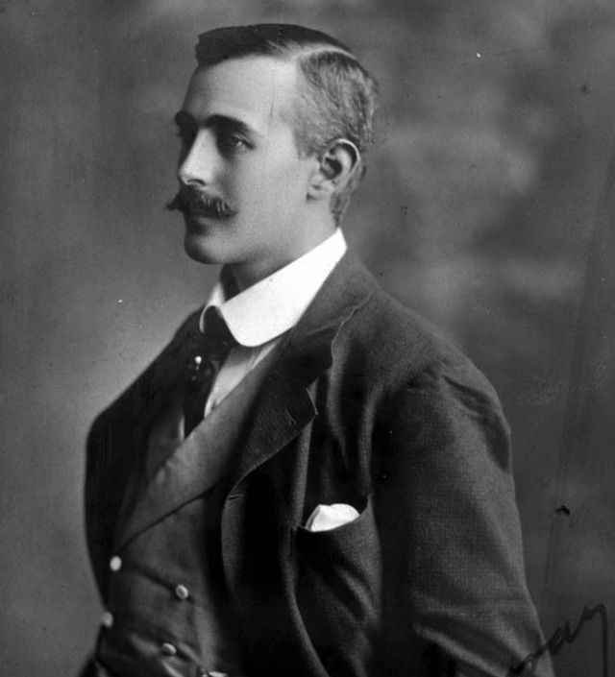
HR Person / Recruiter
First person to see your CV
Probably non-technical
Decides whether or not your CV should be sent to someone technical

Slide 10
HR Person / Recruiter Questions (1/3)
Do you have appropriate skills for the role?
Keyword matching
“Sorry, you need JavaScript experience, but all I can see in the web development section is AngularJS and jQuery”
Pays to be explicit and verbose about skills, but more on that later
Vague understanding of the job specification by talking to the Hiring Manager

Slide 11
HR Person / Recruiter Questions (2/3)
Are you employable?
Does your work experience have large and unexplained gaps?
Do you have lots of jobs that weren’t contracts and lasted less than two years?
Do you say nasty things about previous employers?
Does your LinkedIn profile match your CV?
Does Googling your name bring up your blog about how you’re trying to overthrow the government?
Basically:
If they’re internal HR, they want to know if you’re likely to be a liability to the company
If they’re a recruiter, they want to know if they’re going to look like an idiot when you reveal in the interview that you were fired from your previous three roles
Later…
We’ll be covering how to make sure your mottled job history looks reasonable

Slide 12
HR Person / Recruiter Questions (3/3)
Are you eligible to work in the UK?
Is your current location listed as non-UK?
Have most of your jobs been in countries outside the EU?
If you have a “non-English” name, have you been clear about the citizenship you hold?
Because…
Most companies are too lazy to sponsor foreign workers
No-one wants to waste time on interviews for someone who can’t legally accept a job they’re offered
Later…
We’ll talk about how to make sure you don’t get excluded at this stage…

Slide 13
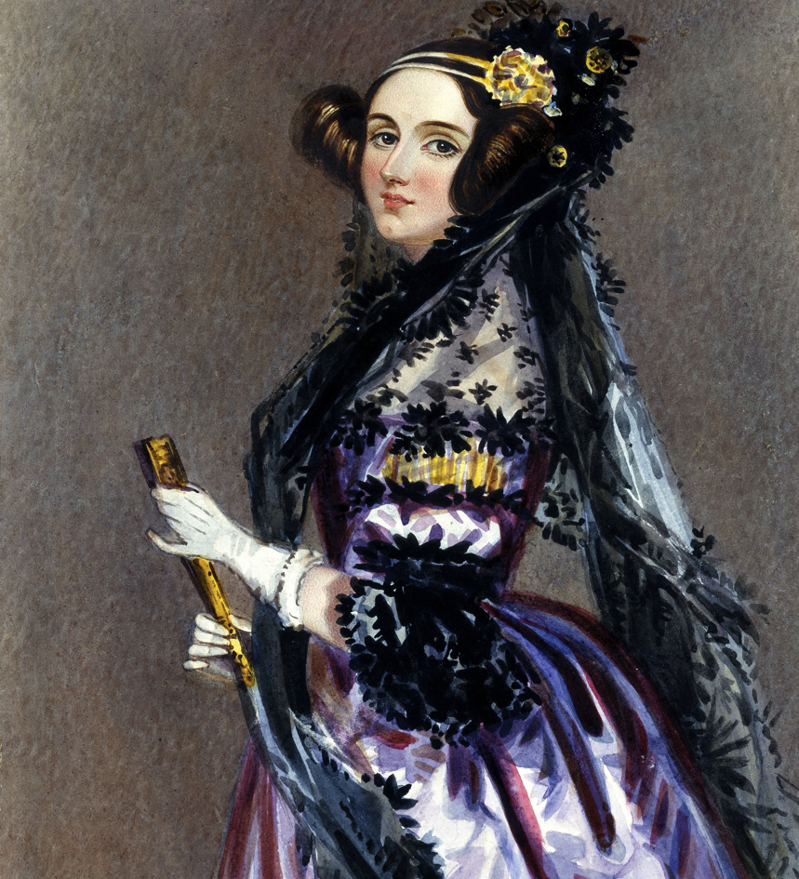
Hiring Manager
(Usually) Senior technical person
Quite possibly your future line manager
Has much better things to do than read your CV
Is it worth investing time in getting you in for a phone or in-person interview?

Slide 14
Hiring Manager Questions (1/3)
Do you have actual commercial Perl experience?
… or is Perl one of many languages you wrote a few lines of once?
… are you a sysadmin who has done terrible, terrible things in Perl?

Slide 15
Hiring Manager Questions (2/3)
Do you have the other required skills?
Knows which ones are important and which are not
Actually knows what the candidate requirements are
Hiring Manager secretly believes she could have just written “Senior Perl Developer”, and the right people would have applied
HR bullied her in to writing a job description

Slide 16
Hiring Manager Questions (3/3)
Bonus points: do you have any open-source work?
Not required, but usually a big win
Shows you actually care about programming
We’ll talk about how to dress this up later, even if you have very little

Slide 17
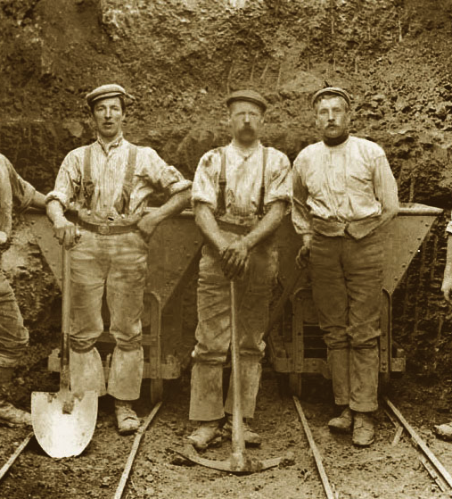
The Interviewing Developers
Your future coworkers
Often a random selection of developers who the Hiring Manager could lay her hands on
They have absolutely no idea what they’re doing
Probably the people with the most sway over if you get hired
Stave off boredom during the interview and form an opinion on if they would enjoy working with you

Slide 18
The Interviewing Developers Questions (1/3)
Do you know about Perl and programming?
This may well take the form of random trivia questions they recently learned the answers to
“What does this snippet of code I pulled from a Code Golf site do?”
All sorts of stupid questions about the comma operator
“What’s a Monad?”
You need to give them more interesting things to talk about instead, and we’ll talk about how in a minute

Slide 19
The Interviewing Developers Questions (2/3)
Could they work with you?
Are you friendly and do you smile?
Do you get irritated and flustered by inane technical trivia questions?
Do you smell funny, and did you wear a suit?
Or at least business casual
If you can’t be bothered to dress up a little bit for your interview, the Hiring Manager knows that you are going to be a huge pain in the ass to manage
True fact.

Slide 20

The Interviewing Developers Questions (3/3)
They don’t do this for a living
You need to help them find interesting things about you to talk about
They will be desperately scanning your CV for interesting things to talk about to avoid awkward small talk
Your CV should be full of interesting things about technology you want to talk about

Slide 21

The Gatekeepers: Summary
Your CV needs to help each of them answer their questions
Nobody enjoys reading CVs
The best anyone will do is skim it
Make it easy for them to answer their questions
Avoid any show-stopper bugs

Slide 22

Summary Section

Slide 23

Summary Section: How to get it wrong
“I am a self starter and also a quick learner. I am highly motivated, with ambitions to work for a company whose high standards match my own. I am conscientious and experienced in all aspects of software development, including PERL, CGI, and HTML programming languages.
A description of your character attributes and career goals
No-one cares
Recruiters and HR people think programmers are weird already, this won’t help
Hiring managers have off-the-charts cynicism, and know it’s a bunch of twaddle
Interviewing developers will think you’re an idiot.

Slide 24
Summary Section: The Good News
It’s possible to do this well enough that people won’t really bother reading the rest of the CV
You can give each of the audiences something to read
You will need precisely 3 bullet points

Slide 25
Summary Section: HR Person / Recruiter
Help tell them you’re in the right place
Repeat the job title back to them
Throw in some of the skills that were listed as required
Help them to understand that they are, in fact, looking at a CV for a “Senior Perl Developer” by writing it down
“I am a Senior Perl Developer with 15 years experience, including exposure to Puppet and Chef and JavaScript, CSS and AJAX”

Slide 26
Summary Section: Hiring Manager
DEMONSTRATE UNDERSTANDING
Don’t just claim skills, prove them
Mediocre: “8 years of Perl, testing, DBIx::Class, Plack, Catalyst, CGI, Test::More”
Excellent: “I'm an active proponent of Modern Perl - I love the power of composing resultsets in DBIx::Class, using Plack to hide web-server implementation details, and the way that Test::Builder-based testing tools all interact well with each other”
Say what you like or dislike about the tools you’ve used, and observations on them
This is approximately a million times more convincing than just listing keywords

Slide 27
Summary Section: The Interviewing Developers
Give them interesting things to talk to you about
“My personal development projects include an automated cat treadmill using Arduino with a digital signal processing component written in Perl using the Event module” OR
“In my free time, I'm currently working on an app that converts photographs of crossword puzzles in to playable games” OR
“I teach an after-work class to my colleagues in using AngularJS”
The more interesting things you have to talk about, the more passion you’ll show about programming …
… and the less time they’ll have to ask inane brainteasers they read online

Slide 28
Summary Section: Summary
Summary
I am a Senior Perl Developer with 15 years experience, including exposure to Puppet, Chef, JavaScript, CSS and AJAX.
I'm an active proponent of Modern Perl - I love the power of composing resultsets in DBIx::Class, using Plack to hide web-server implementation details, and the way that Test::Builder-based testing tools all interact well with each other
My personal development projects include an automated cat treadmill using Arduino with a digital signal processing component written in Perl using the Event module
If you get this right, that’s all you really need to get an interview
And to have interesting things to talk about in your interview
Everybody hates reading CVs, so save everyone some time by putting the important stuff succinctly at the start
Just don’t screw up the rest of the CV
Alarmingly easy
That’s what we’ll talk about next

Slide 29

Skills

Slide 30
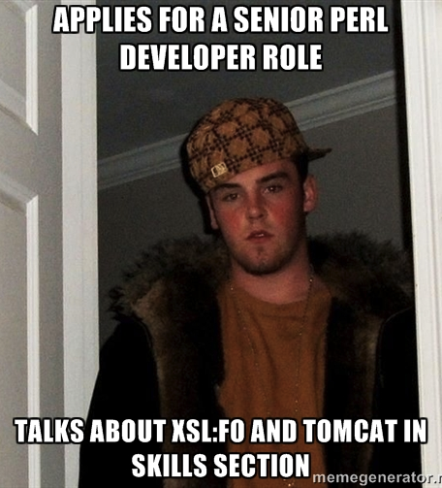
Skills The Basics
TALK ABOUT THE IMPORTANT THINGS FIRST AND AT LENGTH
If your experience with Java Server Pages takes up as much ink as your experience with Template Toolkit, you are DOING IT WRONG
If your experience with Java Server Pages takes up as much ink as the fact you once read the Class::MOP documentation in depth, you are STILL DOING IT WRONG

Slide 31
Skills Bad Example
Perl (7 years)
Java (2 years)
Linux (5.5 years)
CGI (2 years)
FTP (12 years)
T-SQL (1 year)
Only the HR Person / Recruiter cares
They don’t know what Linux or FTP are anyway
They have seen 5,000 CVs like this

Slide 32
Skills Good Example
Perl
Testing
I have a deep and broad experience with Perl's testing tools. Most general testing I have approached with Test::More, but I've worked in teams with an aggressive focus on unit testing with Test::Class. My Test::More tests are usually supplemented by Test::Differences because it provides a considerably better output for deep comparison of data structures. I've used Devel::Cover to identify areas for more attention when extending test suites, but in my experience, chasing test coverage numbers leads to brittle tests.
Web Frameworks
I have extensive experience of using Catalyst, and have appreciated the development team's focus on backwards compatibility in several complicated upgrade situations. I have some exposure to both Dancer - which seems excellent for lightweight applications - and Mojolicious, whose focus on modern web technologies like web sockets allows for some cool features. Tying it all together, I've found Plack's abstraction of the underlying webserver to be very useful, especially when it comes to some of the more interesting middleware.
Talk about your experiences as proof that you’ve actually used the tools you talk about, and have formed an opinion on them
Shows the Hiring Manager your experience really happened
Gives developers something to talk to you about

Slide 33
Skills Good Example
Perl
Testing
I have a deep and broad experience with Perl's testing tools. Most general testing I have approached with Test::More, but I've worked in teams with an aggressive focus on unit testing with Test::Class. My Test::More tests are usually supplemented by Test::Differences because it provides a considerably better output for deep comparison of data structures. I've used Devel::Cover to identify areas for more attention when extending test suites, but in my experience, chasing test coverage numbers leads to brittle tests.
Web Frameworks
I have extensive experience of using Catalyst, and have appreciated the development team's focus on backwards compatibility in several complicated upgrade situations. I have some exposure to both Dancer - which seems excellent for lightweight applications - and Mojolicious, whose focus on modern web technologies like web sockets allows for some cool features. Tying it all together, I've found Plack's abstraction of the underlying webserver to be very useful, especially when it comes to some of the more interesting middleware.
Show off your battle scars
Insights you’ve gained from experience
(Make sure you’re actually able to say something interesting about this in the interview)

Slide 34
Skills Good Example
Perl
Testing
I have a deep and broad experience with Perl's testing tools. Most general testing I have approached with Test::More, but I've worked in teams with an aggressive focus on unit testing with Test::Class. My Test::More tests are usually supplemented by Test::Differences because it provides a considerably better output for deep comparison of data structures. I've used Devel::Cover to identify areas for more attention when extending test suites, but in my experience, chasing test coverage numbers leads to brittle tests.
Web Frameworks
I have extensive experience of using Catalyst, and have appreciated the development team's focus on backwards compatibility in several complicated upgrade situations. I have some exposure to both Dancer - which seems excellent for lightweight applications - and Mojolicious, whose focus on modern web technologies like web sockets allows for some cool features. Tying it all together, I've found Plack's abstraction of the underlying webserver to be very useful, especially when it comes to some of the more interesting middleware.
Talk about something slightly contentious, or an interesting opinion
Gives the interviewers something to talk about that you can prepare an awesome answer to

Slide 35
Skills Good Example
Perl
Testing
I have a deep and broad experience with Perl's testing tools. Most general testing I have approached with Test::More, but I've worked in teams with an aggressive focus on unit testing with Test::Class. My Test::More tests are usually supplemented by Test::Differences because it provides a considerably better output for deep comparison of data structures. I've used Devel::Cover to identify areas for more attention when extending test suites, but in my experience, chasing test coverage numbers leads to brittle tests.
Web Frameworks
I have extensive experience of using Catalyst, and have appreciated the development team's focus on backwards compatibility in several complicated upgrade situations. I have some exposure to both Dancer - which seems excellent for lightweight applications - and Mojolicious, whose focus on modern web technologies like web sockets allows for some cool features. Tying it all together, I've found Plack's abstraction of the underlying webserver to be very useful, especially when it comes to some of the more interesting middleware.
These are great weasel words for when you want to talk about something you’ve played with a bit, but aren’t prepared to answer detailed questions on…

Slide 36
Skills Good Example
Perl
Testing
I have a deep and broad experience with Perl's testing tools. Most general testing I have approached with Test::More, but I've worked in teams with an aggressive focus on unit testing with Test::Class. My Test::More tests are usually supplemented by Test::Differences because it provides a considerably better output for deep comparison of data structures. I've used Devel::Cover to identify areas for more attention when extending test suites, but in my experience, chasing test coverage numbers leads to brittle tests.
Web Frameworks
I have extensive experience of using Catalyst, and have appreciated the development team's focus on backwards compatibility in several complicated upgrade situations. I have some exposure to both Dancer - which seems excellent for lightweight applications - and Mojolicious, whose focus on modern web technologies like web sockets allows for some cool features. Tying it all together, I've found Plack's abstraction of the underlying webserver to be very useful, especially when it comes to some of the more interesting middleware.
Putting certain skills in bold looks a little weird, but helps HR / Recruiters find keywords mentioned in the job spec

Slide 37
Skills More Skills
Systems Administraction
I have used Linux commercially, on my desktop, and on my personal servers since 1998. I have used Redhat, Slackware, and Debian, before finally settling on Ubuntu, as I appreciate its long-term release policy. The website I run for my local cat-fancier group is setup using Puppet, running Postgres via nginx.
Front-End
I have excellent experience with Javascript. Javascript's prototype-based inheritance model is a little unusual, as are its block-scoping rules. I have used jQuery and EmberJS commercially, and have recently started dabbling with AngularJS in my free time. I am able to both describe and - with much practice - pronounce 'CSS specificity'.
Other Skills
I would be happy to discuss my commercial experience with and exposure to: Agile SCRUM, Kanban, Postgres, MySQL, NodeJS, mod_perl, Apache, Befunge, INTERCAL, Binary lambda calculus, and IP over Avian Carriers.
Use the same approach for non-Perl skills you want to talk about

Slide 38
Skills More Skills
Systems Administraction
I have used Linux commercially, on my desktop, and on my personal servers since 1998. I have used Redhat, Slackware, and Debian, before finally settling on Ubuntu, as I appreciate its long-term release policy. The website I run for my local cat-fancier group is setup using Puppet, running Postgres via nginx.
Front-End
I have excellent experience with Javascript. Javascript's prototype-based inheritance model is a little unusual, as are its block-scoping rules. I have used jQuery and EmberJS commercially, and have recently started dabbling with AngularJS in my free time. I am able to both describe and - with much practice - pronounce 'CSS specificity'.
Other Skills
I would be happy to discuss my commercial experience with and exposure to: Agile SCRUM, Kanban, Postgres, MySQL, NodeJS, mod_perl, Apache, Befunge, INTERCAL, Binary lambda calculus, and IP over Avian Carriers.
Demonstrate understanding by giving opinions

Slide 39
Skills More Skills
Systems Administraction
I have used Linux commercially, on my desktop, and on my personal servers since 1998. I have used Redhat, Slackware, and Debian, before finally settling on Ubuntu, as I appreciate its long-term release policy. The website I run for my local cat-fancier group is setup using Puppet, running Postgres via nginx.
Front-End
I have excellent experience with Javascript. Javascript's prototype-based inheritance model is a little unusual, as are its block-scoping rules. I have used jQuery and EmberJS commercially, and have recently started dabbling with AngularJS in my free time. I am able to both describe and - with much practice - pronounce 'CSS specificity'.
Other Skills
I would be happy to discuss my commercial experience with and exposure to: Agile SCRUM, Kanban, Postgres, MySQL, NodeJS, mod_perl, Apache, Befunge, INTERCAL, Binary lambda calculus, and IP over Avian Carriers.
Demonstrate understanding by highlighting interesting technical facets of things you’ve worked on
Again, this will give interviewing developers something to talk to you about

Slide 40
Skills More Skills
Systems Administraction
I have used Linux commercially, on my desktop, and on my personal servers since 1998. I have used Redhat, Slackware, and Debian, before finally settling on Ubuntu, as I appreciate its long-term release policy. The website I run for my local cat-fancier group is setup using Puppet, running Postgres via nginx.
Front-End
I have excellent experience with Javascript. Javascript's prototype-based inheritance model is a little unusual, as are its block-scoping rules. I have used jQuery and EmberJS commercially, and have recently started dabbling with AngularJS in my free time. I am able to both describe and - with much practice - pronounce 'CSS specificity'.
Other Skills
I would be happy to discuss my commercial experience with and exposure to: Agile SCRUM, Kanban, Postgres, MySQL, NodeJS, mod_perl, Apache, Befunge, INTERCAL, Binary lambda calculus, and IP over Avian Carriers.
Nothing wrong with throwing in a little bit of personality
Especially as you’ll probably be nervous in the interview

Slide 41
Skills More Skills
Systems Administraction
I have used Linux commercially, on my desktop, and on my personal servers since 1998. I have used Redhat, Slackware, and Debian, before finally settling on Ubuntu, as I appreciate its long-term release policy. The website I run for my local cat-fancier group is setup using Puppet, running Postgres via nginx.
Front-End
I have excellent experience with Javascript. Javascript's prototype-based inheritance model is a little unusual, as are its block-scoping rules. I have used jQuery and EmberJS commercially, and have recently started dabbling with AngularJS in my free time. I am able to both describe and - with much practice - pronounce 'CSS specificity'.
Other Skills
I would be happy to discuss my commercial experience with and exposure to: Agile SCRUM, Kanban, Postgres, MySQL, NodeJS, mod_perl, Apache, Befunge, INTERCAL, Binary lambda calculus, and IP over Avian Carriers.
Don’t go overboard with the personality though…

Slide 42
Skills More Skills
Systems Administraction
I have used Linux commercially, on my desktop, and on my personal servers since 1998. I have used Redhat, Slackware, and Debian, before finally settling on Ubuntu, as I appreciate its long-term release policy. The website I run for my local cat-fancier group is setup using Puppet, running Postgres via nginx.
Front-End
I have excellent experience with Javascript. Javascript's prototype-based inheritance model is a little unusual, as are its block-scoping rules. I have used jQuery and EmberJS commercially, and have recently started dabbling with AngularJS in my free time. I am able to both describe and - with much practice - pronounce 'CSS specificity'.
Other Skills
I would be happy to discuss my commercial experience with and exposure to: Agile SCRUM, Kanban, Postgres, MySQL, NodeJS, mod_perl, Apache, Befunge, INTERCAL, Binary lambda calculus, and IP over Avian Carriers.
This is where you can finally tell the world about all of your experience with XSLT, Java Server Pages, and a bunch of other technology no-one hiring your for a Perl developer position cares about. Go wild.

Slide 43

Open Source Experience

Slide 44
Open Source Experience
Easiest way to prove you actually care about programming
One of the few pieces of “technical screening” a non-technical person can do
How much you have is going to determine how you should present it…

Slide 45

Open Source Experience “I am defined by Github”

Slide 46
Open Source Experience “I am defined by Github”
Open Source and Community
Test::BDD::Cucumber
Author of this fully-featured Perl BDD framework, based on the popular Ruby tool of the same name. Test::BDD::Cucumber now has an active group of committers, was the focus of a Linux Magazine article, and is distributed in Debian packages.
ziprip.js
A NodeJS and vanilla JS library for extracting postal addresses from web pages. Was originally part of code I wrote for a (now defunct) start-up, and has found some use as part of various browser plugins.
Template::Plugin::StashValidate
A mashup of Template Toolkit and MooseX::Params::Validate to allow runtime checking of the the Template Toolkit `stash`.
Other projects
I maintain 15 CPAN modules: http://search.cpan.org/~sargie/
I am active participant on various projects on Github: https://github.com/sheriff
I have had a number of technical articles published in The Perl Journal, Perl.com, and DrDobbs
I have spoken variously at YAPC::EU, the London Perl Workshop, and local Perl Monger technical events
If you have lots, this should be at least as prominent as your skills
For HR and Recruiters, it might as well be antique hieroglyphics carved on stone – no idea what it means, but pretty sure it’s valuable
Hiring manager will know you have “passion”
The Interviewing Developers will have lots to talk to you about
Let’s take a closer look…

Slide 47
Open Source Experience “I am defined by Github”
Open Source and Community
Test::BDD::Cucumber
Author of this fully-featured Perl BDD framework, based on the popular Ruby tool of the same name. Test::BDD::Cucumber now has an active group of committers, was the focus of a Linux Magazine article, and is distributed in Debian packages.
ziprip.js
A NodeJS and vanilla JS library for extracting postal addresses from web pages. Was originally part of code I wrote for a (now defunct) start-up, and has found some use as part of various browser plugins.
Template::Plugin::StashValidate
A mashup of Template Toolkit and MooseX::Params::Validate to allow runtime checking of the the Template Toolkit `stash`.
Other projects
I maintain 15 CPAN modules: http://search.cpan.org/~sargie/
I am active participant on various projects on Github: https://github.com/sheriff
I have had a number of technical articles published in The Perl Journal, Perl.com, and DrDobbs
I have spoken variously at YAPC::EU, the London Perl Workshop, and local Perl Monger technical events
Break out one or two of the more interesting pieces, rather than everything you’ve done ever

Slide 48
Open Source Experience “I am defined by Github”
Open Source and Community
Test::BDD::Cucumber
Author of this fully-featured Perl BDD framework, based on the popular Ruby tool of the same name. Test::BDD::Cucumber now has an active group of committers, was the focus of a Linux Magazine article, and is distributed in Debian packages.
ziprip.js
A NodeJS and vanilla JS library for extracting postal addresses from web pages. Was originally part of code I wrote for a (now defunct) start-up, and has found some use as part of various browser plugins.
Template::Plugin::StashValidate
A mashup of Template Toolkit and MooseX::Params::Validate to allow runtime checking of the the Template Toolkit `stash`.
Other projects
I maintain 15 CPAN modules: http://search.cpan.org/~sargie/
I am active participant on various projects on Github: https://github.com/sheriff
I have had a number of technical articles published in The Perl Journal, Perl.com, and DrDobbs
I have spoken variously at YAPC::EU, the London Perl Workshop, and local Perl Monger technical events
Name-drop the other stuff you do and link to your repositories
Top tip: if you don’t have anything on CPAN or in Github, don’t include links to your CPAN ID and Github page
People actually do this

Slide 49
Open Source Experience “I am defined by Github”
Open Source and Community
Test::BDD::Cucumber
Author of this fully-featured Perl BDD framework, based on the popular Ruby tool of the same name. Test::BDD::Cucumber now has an active group of committers, was the focus of a Linux Magazine article, and is distributed in Debian packages.
ziprip.js
A NodeJS and vanilla JS library for extracting postal addresses from web pages. Was originally part of code I wrote for a (now defunct) start-up, and has found some use as part of various browser plugins.
Template::Plugin::StashValidate
A mashup of Template Toolkit and MooseX::Params::Validate to allow runtime checking of the the Template Toolkit `stash`.
Other projects
I maintain 15 CPAN modules: http://search.cpan.org/~sargie/
I am active participant on various projects on Github: https://github.com/sheriff
I have had a number of technical articles published in The Perl Journal, Perl.com, and DrDobbs
I have spoken variously at YAPC::EU, the London Perl Workshop, and local Perl Monger technical events
Talk about any speaking or writing you’ve done
If you have a technical blog, and it’s coherent, link to it
You don’t have to point out that lightening talks were lightening talks
Again: if you have lots of this stuff, make it as prominent as the Skills section

Slide 50

Open Source Experience Part-Time Contributor

Slide 51
Open Source Experience Part-Time Contributor
Open Source and Community
I am an active participant on GitHub, and I maintain the `FooBar` module, originally by Graham Barr and Gisle Aas. I have been working closely with the "Perl Toolchain Gang", the maintainers of essential Perl modules like Module::Build, local::lib, and ExtUtils::MakeMaker - in the last month I've had 7 pull-requests accepted in to ExtUtils::MakeMaker, have raised numerous issues against other pieces of the toolchain.
GitHub: http://github.com/L33tProgrammer
CPAN: http://cpan.com/~1337
Speaking and Writing
In 2010 I gave a talk on Sprinkle::Form, a yet-to-be released CPAN module for frobinating the whizzbanger. I maintain a blog on best-practice software engineering via http://blogs.perl.org/
Still put it prominently
It’s still awesome

Slide 52
Open Source Experience Part-Time Contributor
Open Source and Community
I am an active participant on GitHub, and I maintain the `FooBar` module, originally by Graham Barr and Gisle Aas. I have been working closely with the "Perl Toolchain Gang", the maintainers of essential Perl modules like Module::Build, local::lib, and ExtUtils::MakeMaker - in the last month I've had 7 pull-requests accepted in to ExtUtils::MakeMaker, have raised numerous issues against other pieces of the toolchain.
GitHub: http://github.com/L33tProgrammer
CPAN: http://cpan.com/~1337
Speaking and Writing
In 2010 I gave a talk on Sprinkle::Form, a yet-to-be released CPAN module for frobinating the whizzbanger. I maintain a blog on best-practice software engineering via http://blogs.perl.org/
Which projects have you been working on? Name-drop them, and then talk them up
Reflected glory is still glory ☺
Link through to CPAN and Github, assuming there’s code there
Did you submit a patch once to a big project? You’re a contributor!

Slide 53
Open Source Experience Part-Time Contributor
Open Source and Community
I am an active participant on GitHub, and I maintain the `FooBar` module, originally by Graham Barr and Gisle Aas. I have been working closely with the "Perl Toolchain Gang", the maintainers of essential Perl modules like Module::Build, local::lib, and ExtUtils::MakeMaker - in the last month I've had 7 pull-requests accepted in to ExtUtils::MakeMaker, have raised numerous issues against other pieces of the toolchain.
GitHub: http://github.com/L33tProgrammer
CPAN: http://cpan.com/~1337
Speaking and Writing
In 2010 I gave a talk on Sprinkle::Form, a yet-to-be released CPAN module for frobinating the whizzbanger. I maintain a blog on best-practice software engineering via http://blogs.perl.org/
Speaking at a local Perl Monger tech-meet still counts as speaking
Got a Perl blog? Mention it
If it’s great, link directly to it
It it’s not so great, just mention it exists…

Slide 54

Open Source Experience Little or None…

Slide 55

tsk, tsk

Slide 56
Open Source Experience Little or None…
You should talk about almost anything you’ve done outside of work
“I’ve been programming for fun since I was in university, and developed a system to allow our department to xyz”
“I am interested in embedded systems, and have recently built a plant watering system using an Arduino”

Slide 57
Open Source Experience Little or None…
What did you learn?
“I’ve recently finished ‘7 Programming Languages in 7 Days’ and was inspired by Erlang’s light-weight threading module to xyz in one of our projects at work”
“I recently attended the London Perl Workshop, where I particularly enjoyed Leo Lapworth’s talk on Plack middleware, which I have subsequently introduced in one of our projects at Foobar Corp”

Slide 58
Open Source Experience Little or None…
Any online courses?
“I’ve recently completed ‘An Introduction to Compilers’ on Coursera, and have applied the sections on state machines to building a business rules engine in my latest project”

Slide 59
Open Source Experience Little or None…
In Summary:
Mention anything you did that showed you enjoy thinking about computers outside of work
Talk about what you learned from it, and why that’s valuable commercial experience
But also…
Go adopt a module and get hacking!

Slide 60
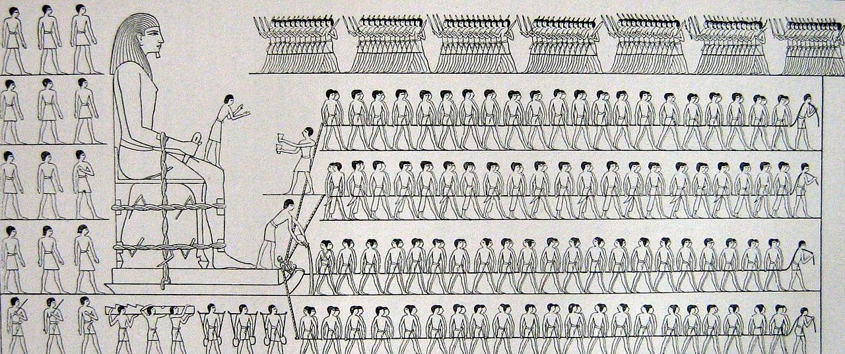
Work Experience

Slide 61
Work Experience General Principles
Don’t list every job ever
Nobody cares you worked at Pizza Hut in 1967
Three or four most recent and most relevant jobs
Any others that are relevant as job title and dates only
Lump up non-technical jobs as a line item
“A variety of non-technical roles”
Your CV should be about three pages, try and get work experience to two pages max
Remember, no-one enjoys reading your CV

Slide 62
Work Experience Role by Role (1/2)
For each role, think about your three audiences
The HR Person / Recruiter wants some keywords to Ctrl+F for
The Hiring Manager wants to know it was an actual Perl programming role
The Interviewing Developers want something interesting to talk to you about
Each of them can have their own bullet point…

Slide 63
Work Experience Role by Role (2/2)
Senior Perl Developer (Contract)
NET-A-PORTER; Jun 2009 – Dec 2012
Skills used: Perl, mod_perl, Catalyst, Test-Driven Development, SCRUM, git, Postgres, Test::More, Test::Class, HTML, Javascript, AMQ
Role overview: Senior Perl Developer helping to design and architect an automated warehousing system for a major ecommerce brand. Originally employed to help build out their automated unit and system testing libraries, my role blah blah blah blah blah
Interesting challenges: The system involved interacting with large, caged robots moving around a physical warehouse, via AMQ. As the system had to maintain total uptime during development and deployment, we employed a several-stage rollout, pulling the system out in to component services and then migrating those over one-by-one to the new system.
Keyword smack down

Slide 64
Work Experience Role by Role (2/2)
Senior Perl Developer (Contract)
NET-A-PORTER; Jun 2009 – Dec 2012
Skills used: Perl, mod_perl, Catalyst, Test-Driven Development, SCRUM, git, Postgres, Test::More, Test::Class, HTML, Javascript, AMQ
Role overview: Senior Perl Developer helping to design and architect an automated warehousing system for a major ecommerce brand. Originally employed to help build out their automated unit and system testing libraries, my role blah blah blah blah blah
Interesting challenges: The system involved interacting with large, caged robots moving around a physical warehouse, via AMQ. As the system had to maintain total uptime during development and deployment, we employed a several-stage rollout, pulling the system out in to component services and then migrating those over one-by-one to the new system.
Short description of the actual job you did

Slide 65
Work Experience Role by Role (2/2)
Senior Perl Developer (Contract)
NET-A-PORTER; Jun 2009 – Dec 2012
Skills used: Perl, mod_perl, Catalyst, Test-Driven Development, SCRUM, git, Postgres, Test::More, Test::Class, HTML, Javascript, AMQ
Role overview: Senior Perl Developer helping to design and architect an automated warehousing system for a major ecommerce brand. Originally employed to help build out their automated unit and system testing libraries, my role blah blah blah blah blah
Interesting challenges: The system involved interacting with large, caged robots moving around a physical warehouse, via AMQ. As the system had to maintain total uptime during development and deployment, we employed a several-stage rollout, pulling the system out in to component services and then migrating those over one-by-one to the new system.
Interesting things to talk about

Slide 66
Work Experience Padding and Gaps
HR Person / Recruiter is looking for red flags
LinkedIn and CV don’t match up for dates or job descriptions
Unexplained large absences
Lots of short non-contract jobs
The Hiring Manager will care too, but you’ll be talking to her, so you’ll have a chance to explain why these gaps or whatever exist
Make sure you have good answers at your finger tips to explain any of these things

Slide 67
Work Experience Papering Up Gaps
If you went travelling (or even on holiday) for a substantial period of a gap in your work history, list it as travelling
Say where you went – people can relate!
Don’t get defensive if asked about it
If you were unemployed and looking, call it “Job seeking”, but talk about productive things you did in that time
Anything you did with computers is fair game
Doubly so if you learnt something or played with a new technology
Date Fudging
Nov 2012 – Jan 2013 can also be written just as “2012 – 2013”
You should come clean about this in the interview, but at least in the interview you can explain why the role lasted such a short time

Slide 68
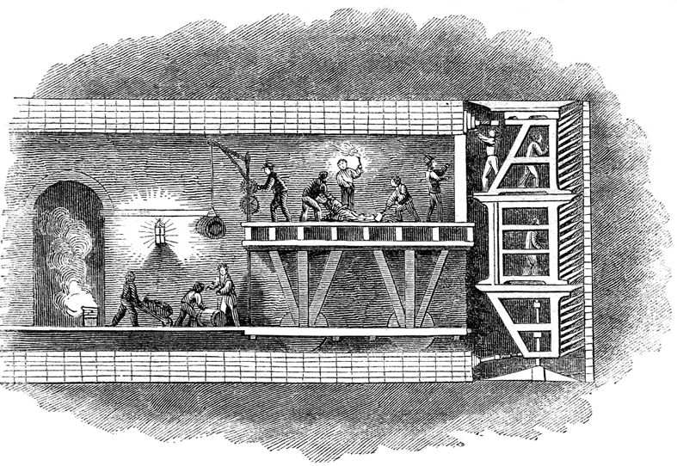
The Boring Stuff

Slide 69
Spot The Difference Between These Two CVs
John Doe
Education
St Wilbert’s Secondary (2000)
A-Levels: French (C), Economics (C), Maths (A)
GCSEs: 12 GCSE’s A-C
Jennifer Dear

Slide 70
Spot The Difference Between These Two CVs
John Doe
Education
St Wilbert’s Secondary (2000)
A-Levels: French (C), Economics (C), Maths (A)
GCSEs: 12 GCSE’s A-C
Jennifer Dear
Answer: John Doe doesn’t have a degree
Some recruiters will care
Unless you have something awesome to write, leave out Education
Awesome is you went to Oxbridge or did an awesome technical or math MSc / PhD

Slide 71
Visa Situation
If you are an EU Citizen, and eligible to work in the UK, write it in big letters at the top
If you have a right to work in the UK, write it in big letters at the top
If you need a Tier 2 visa to work in the UK, write it in big letters at the top
If you don’t live in the UK, but would like to relocate write “Looking to relocate to the UK” in big letters at the top
If an HR Person / Recruiter thinks that employing you will be a big hairy immigration deal, you will go to the bottom of the CV pile
So give them all the information they need up front

Slide 72
Interviews…
Read your CV, make a list of 20 questions you might get asked about them
Write out a perfect answer for each, and read it several times
Try and work your good answers in to any other questions you might get asked
This works really well for phone interviews where you can literally read your answers out

Slide 73
In Summary

Slide 74
Summary
Write your CV for all three audiences
If you are job-seeking, I will help you rewrite your CV – come and get a business card
Make sure it has interesting things to talk about on it
Keep it short

Slide 75
AN OFFER YOU MUST NOT REFUSE
If you are job-seeking in the UK or EU, and you know Perl, I will rewrite your CV for you, so that I can send it to employers, so that I can make cash money.
pete@perl.careers
http://perl.careers/

